Slide 1
The Overhead Movement Alarm Radar
By: Overhead Initiative
Notes:
Hi, I’m ___ and this is [pointing] ___, ___, ___, ___, ___, ___, and ___. We comprise the Overhead Initiative, and we are dedicated to improving the lives of those with visual impairments with the support of assistive technology.

Slide 2
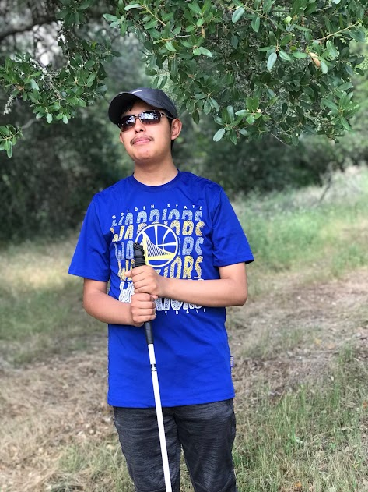
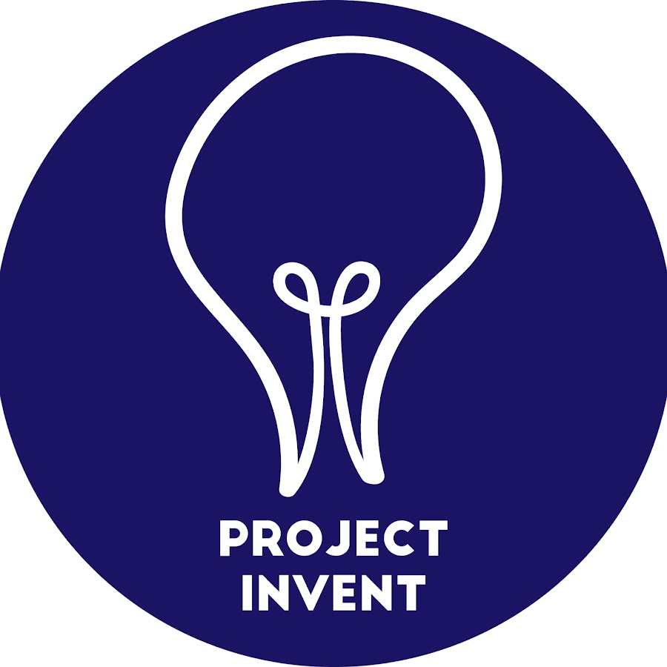
Community Partner: Omar
Notes:
We began our journey as Team Overhead in 2021, associated with the competition Project Invent. Through Project Invent, we were connected with Omar, our visually impaired community partner, who discussed his difficulty with navigation outside of his home, dealing with very narrow sidewalks in addition to overhead objects such as tree limbs and truck mirrors. These obstacles are quite problematic, as Omar cannot effectively navigate around them using a cane.

Slide 3
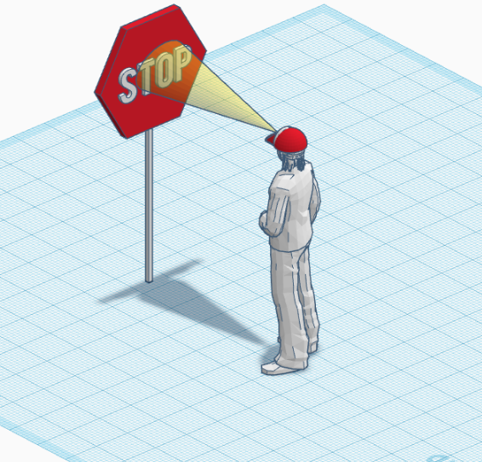
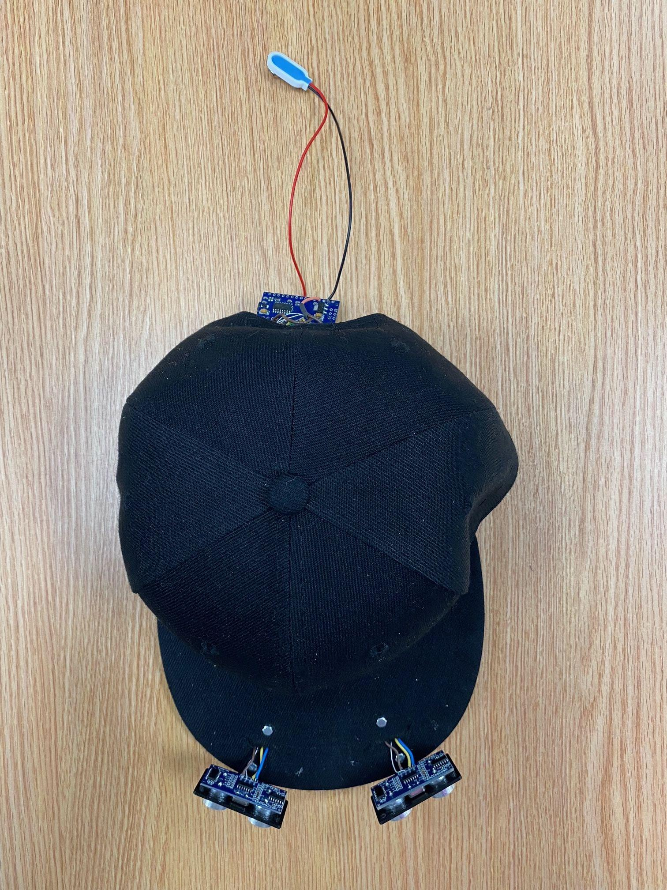
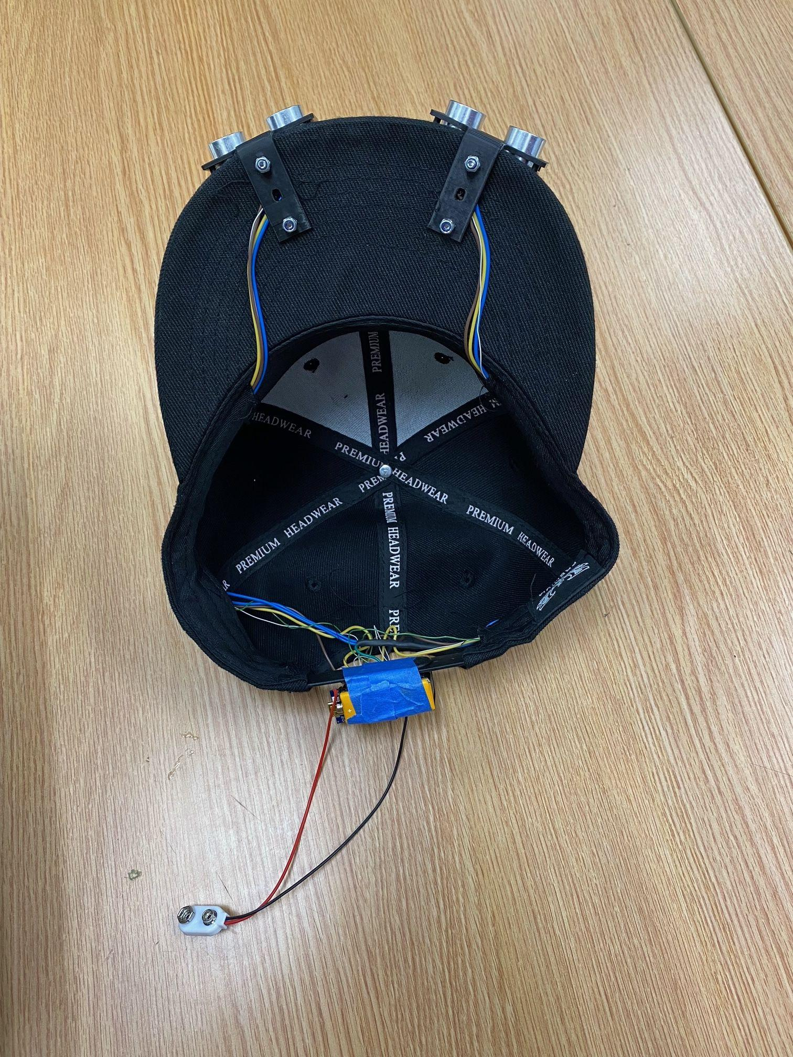
End of Year 2 Prototype
current iteration of the OMAR
Notes:
After starting to understand the problems Omar faced, we realized we could develop a prototype invention to allow him to sense overhead obstacles more effectively, but also noticed the possibility of such a project being ineffective. Yet, we took the initiative anyway, letting our passion and curiosity drive us, eventually managing to successfully create the Overhead Movement Alarm Radar, or the OMAR—a hat using ultrasonic sensors, vibration motors, and an Arduino to alert users of objects detected in their path and their distance/direction, helping them navigate around it. However, despite our eventual success, we faced many challenges while creating our product.

Slide 4
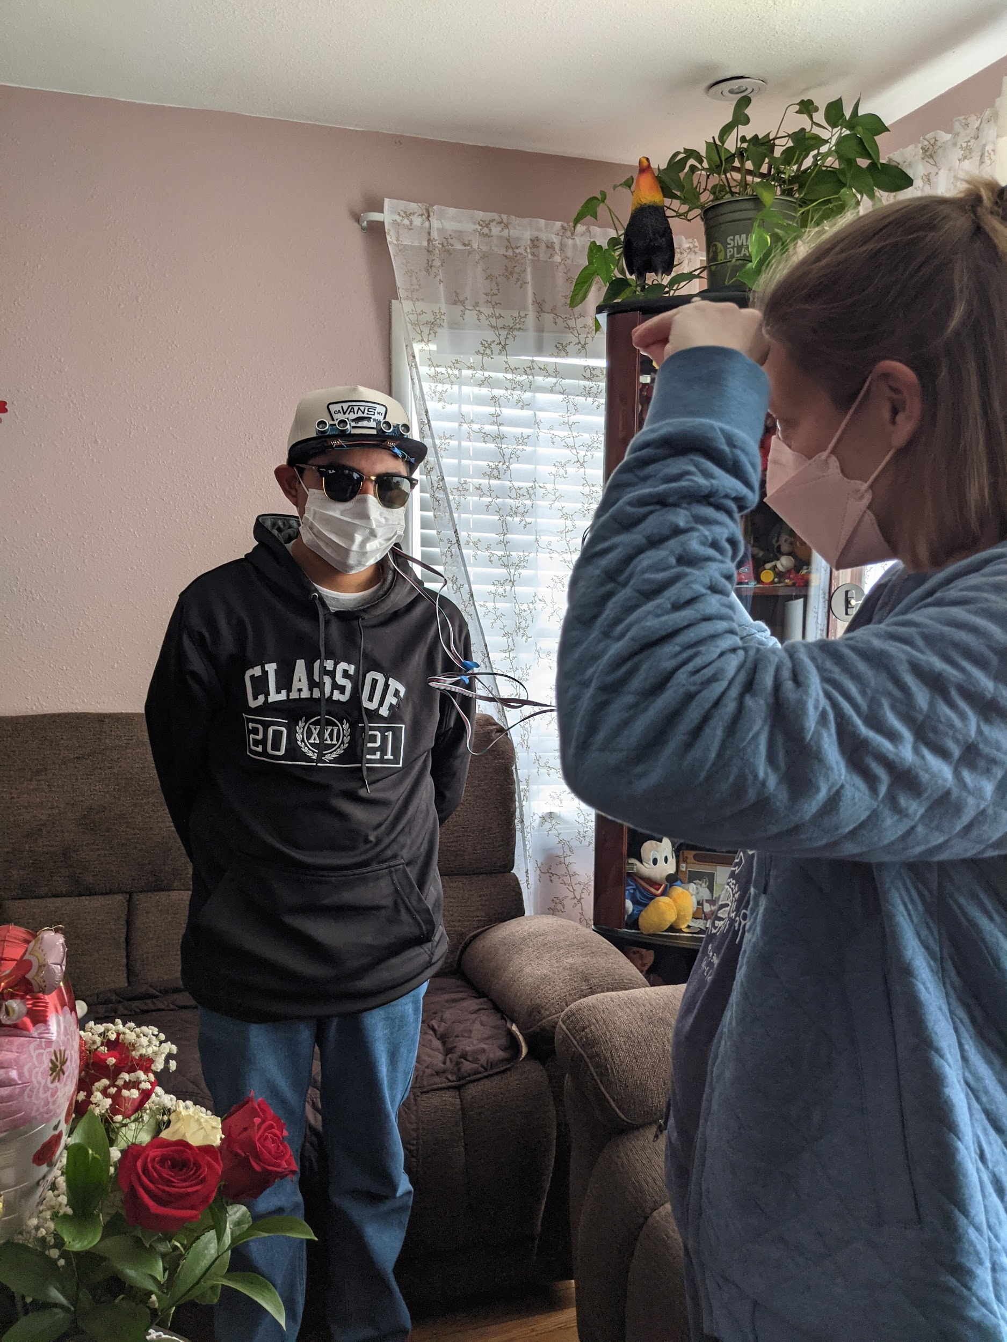
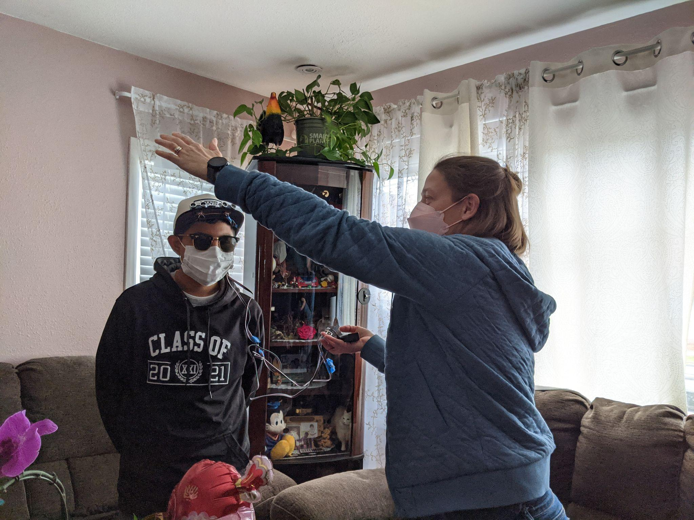
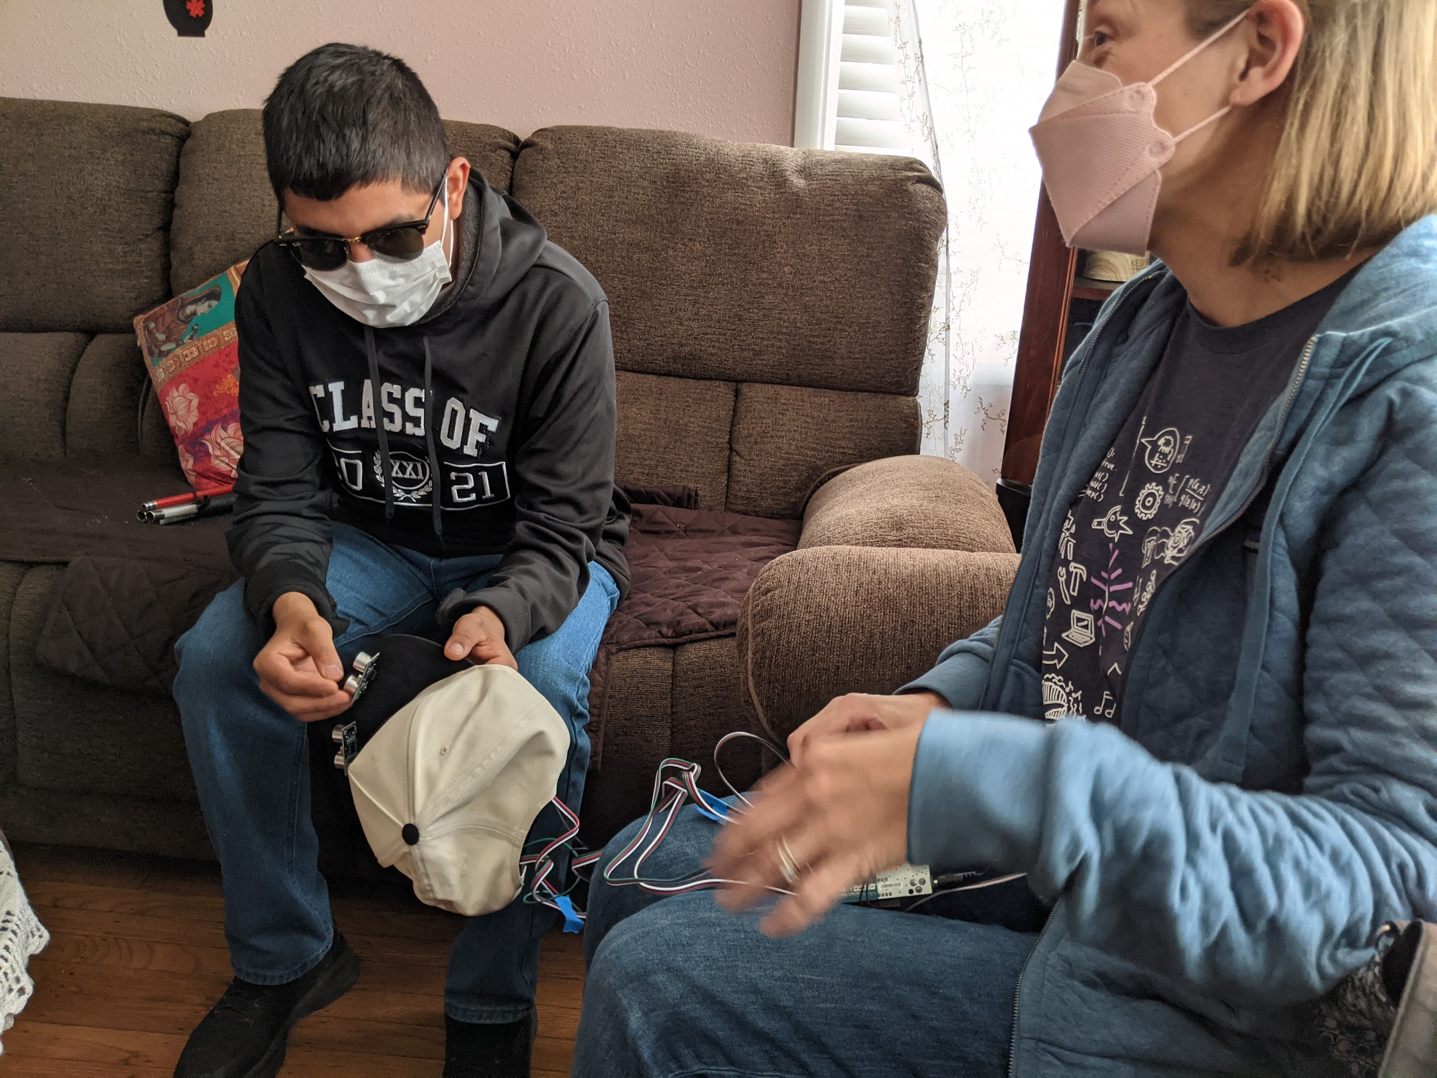
First In-Person Prototype Testing
Omar testing the hat with Ms. Mcclennan
Notes:
At first, working with our community partner was challenging. Zoom allowed us easier communication, but with Omar living so far away, it was difficult to get prototypes and other information to him. In fact, our first prototype was only tested in person by Omar after our teachers drove over to him to get us feedback at the end of our first year.

Slide 5
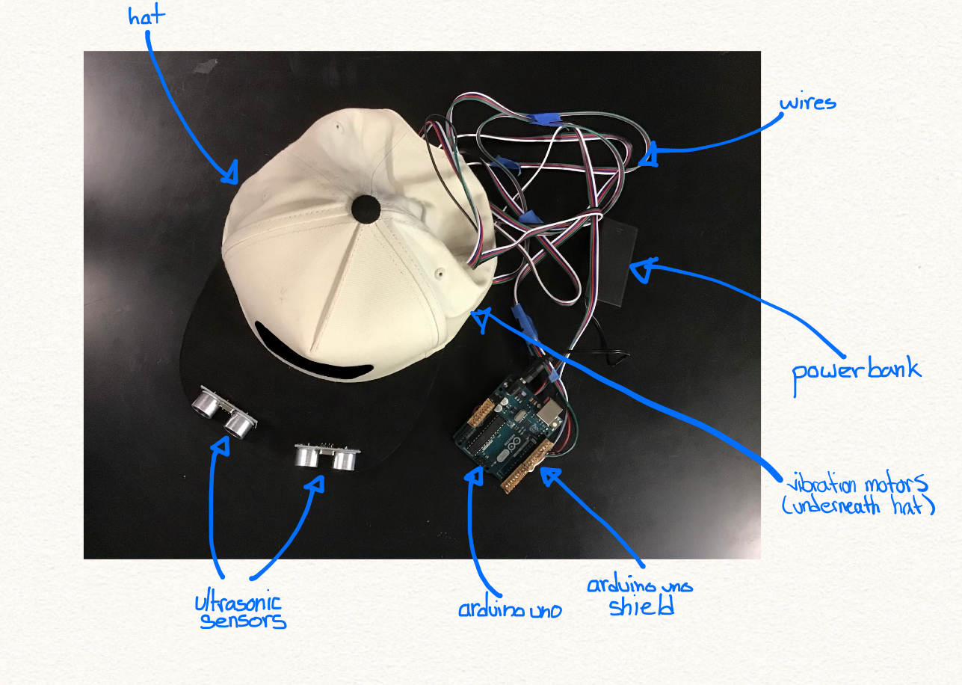
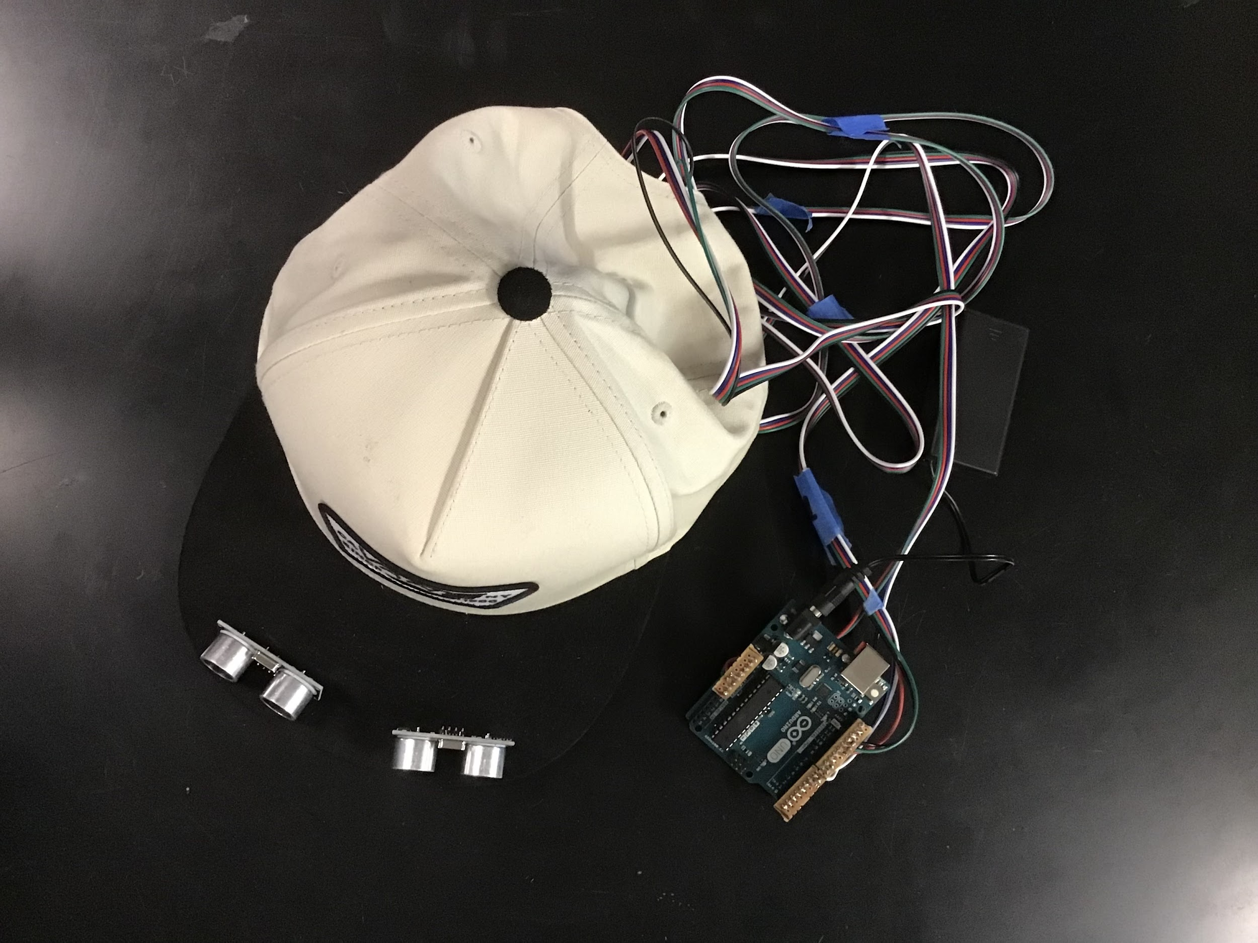
End of Year 1 Prototype
Notes:
In addition, significant issues with our design stood between us and feasibility. In our first prototype, our circuit boards and wiring took up significant space, and the battery was not attached to the hat but rather carried separately by the user. Additionally, our wiring was prone to breakage, as connections often desoldered.

Slide 6
Current Prototype
Notes:
Thus, continuing development, we focused on resolving these issues by gradually making our design more compact, and reinforcing our connections. Our current prototype allows for free movement, with far less visible wiring, and, although wire breakage still remains an issue, it is occurring at a lower frequency than before. As we continue to get the hat ready for production, we plan on further combating the issue of wire breakage with more reinforcement, and also creating a waterproof case for the technology in order to protect it from unpredictable weather.

Slide 7
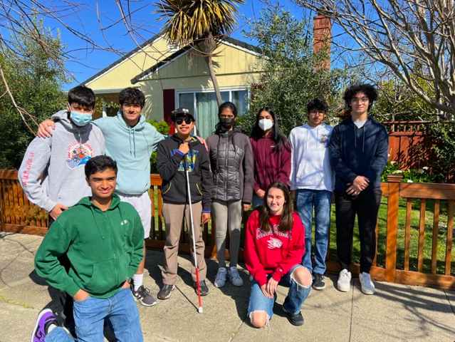
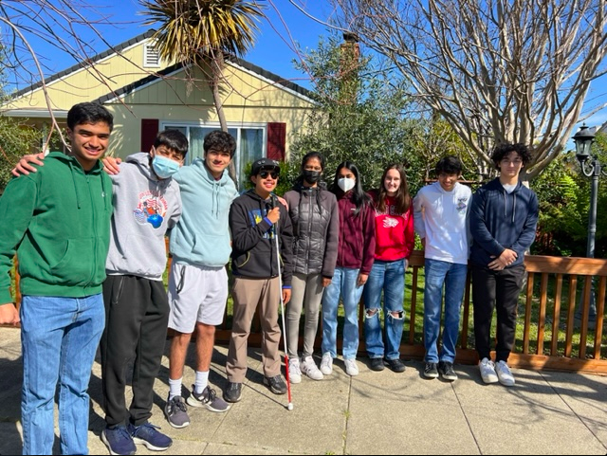
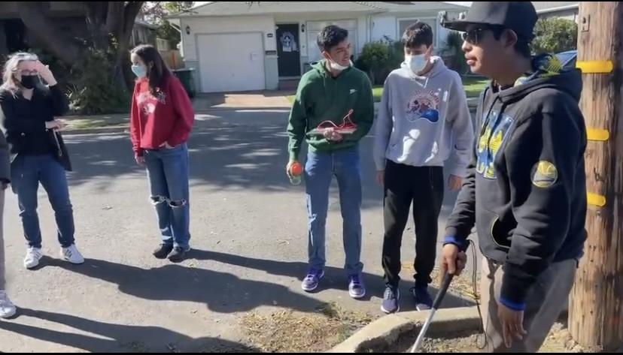
2nd In-Person Testing
Notes:
In order to truly test the capabilities of our project, we traveled to meet Omar in person near the end of our second year. Meeting with Omar and introducing him to our device was a remarkable experience. As we demonstrated how the OMAR worked, it became evident how it could greatly aid his navigation. Omar was able to identify the presence of objects and obstacles around him, and accurately identify his location using the device's feedback. The device enabled him to navigate outdoor environments with newfound security, as we were able to see him effectively avoid tree branches, proving our device’s efficiency.

Slide 8
Future Steps
Improving the hat’s object detection and angles of the sensors
More feedback from Omar and diverse user groups
As mentioned before:
Fixing wire breakage from soldering
“Weather-proofing” the hat for protection
Notes:
However, to enhance the device further, future steps are necessary. Improving the precision of object detection and enhancing the sensor's angles would prove to be effective. Additionally, conducting extensive user testing and gathering feedback from Omar will be crucial in refining the design and ensuring its practicality and effectiveness. With continued development, this device has the potential to help Omar and so many others struggling with visual impairments.

